Slide 1

Exploring Safest Neighbourhoods in Johannesburg , South Africa

Slide 2
Problem Statement
The City of Johannesburg is perceived as a crime ridden city in South Africa that most student outside of the city are reluctant to come and study in Johannesburg. The aim of this project is explore neighbourhoods in the city of Johannesburg where student can stay safely and enjoy the rest of their student life in the city.
This analysis will assist any student who has never been to Johannesburg South Africa to apply to local universities with ease ,knowing that there are safe neighbourhoods to stay in and venues for student entertainment in the city.

Slide 3
Data Description
To support my analysis i will use Foursquare API and machine learning algorithm to explore venues and neighbourhoods in Johannesburg by:
• Finding the safest neighbourhood based on crime statistics
• Geographic locations showing Johannesburg city coordinates
• Choosing popular student accommodation in the neighbourhood

Slide 4
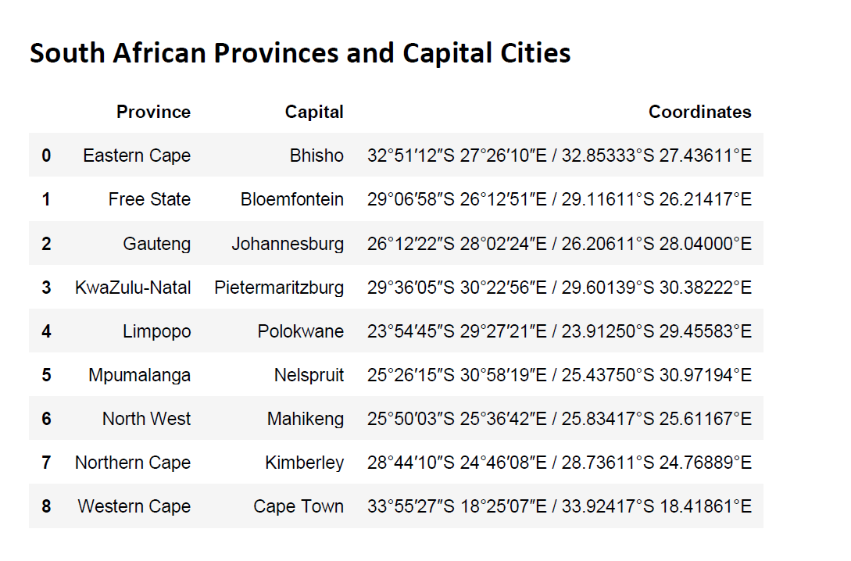

Slide 5
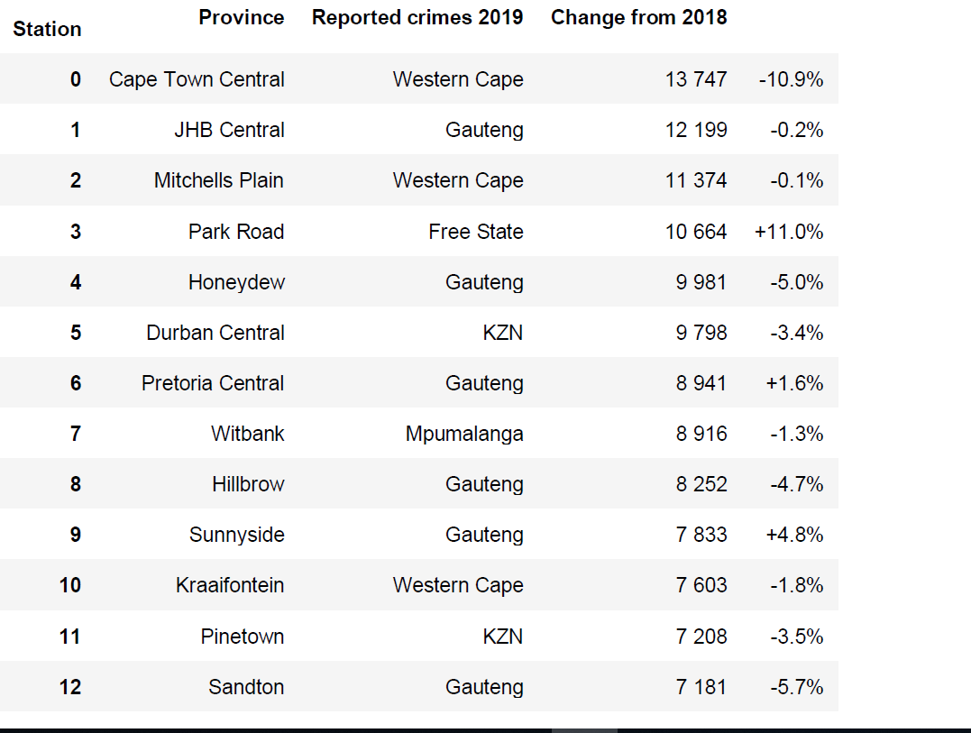
Crime Statistics for 2018\2019

Slide 6
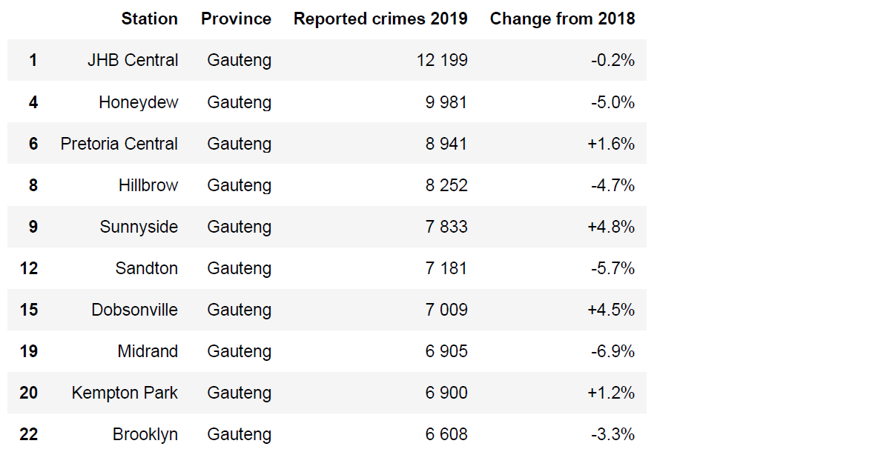
Cleaned up to get Gauteng only

Slide 7
Midrand Map showing latitude and Longitude values

Slide 8
Conclusion
In this study I analysed safest areas in South Africa, Johannesburg for student who want to come study in the country. The area I specifically chose is Midrand for the least crime reported, having a university within it’s area and closest to an international airport.
There is still a lot to be done to further take the crime rate down in most cities in South Africa , if the communities and government (Police) can work together it can be achieved

